Slide 1
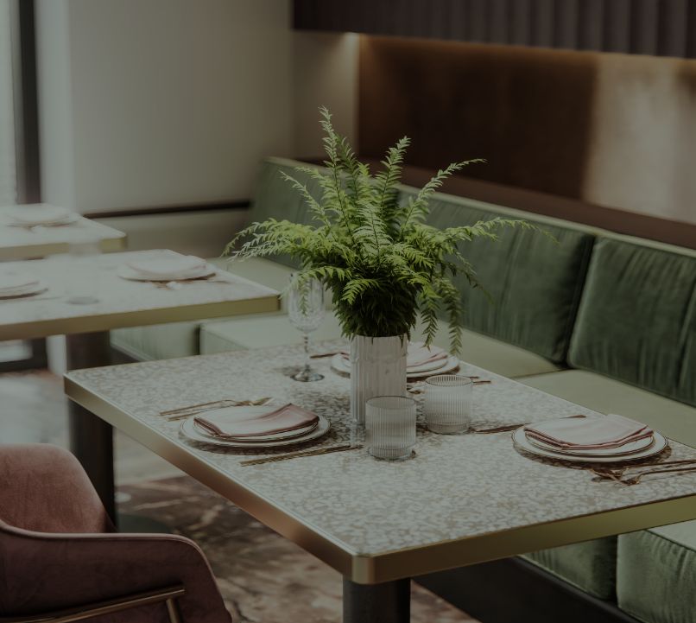
STATED AND UNSTATED REQUIREMENTS

Slide 2

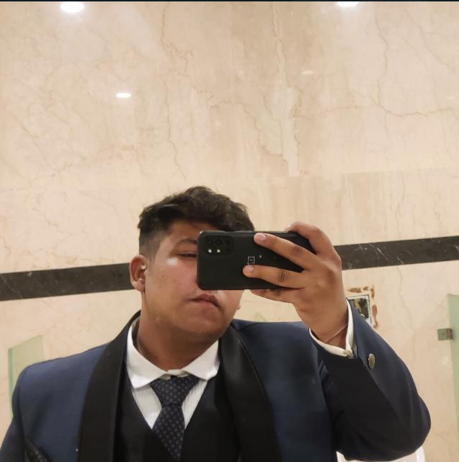
TEAM MEMBERS
JAI khandelwal
Ra2112704010025.
Godfrey ashwanth
RA2112704010020.
Sujal Singh
RA211270401001
PONNURI ANIRUDDHA
RA2112704010015

Slide 3
Stake holders
Customer
Owner
Waiter
Chef

Slide 4
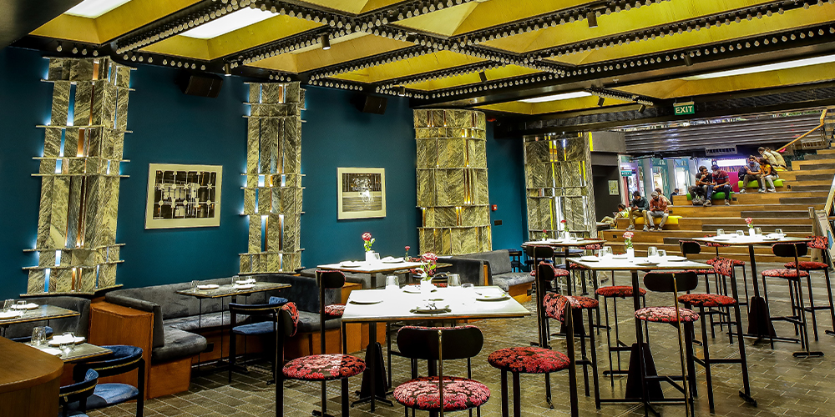
Unstated requirements OWNER
Recommend the brand name to others
More customers than expected
STATED REQUIREMENTS OWNER
Happy customers
Efficient workers
MARGINAL PROFITS

Slide 5

Unstated requirements Chef
Customer satisfaction
No complaints on taste
Good feedback
STATED REQUIREMENTS CHEF
Enough time to prepare
Sufficient materials

Slide 6
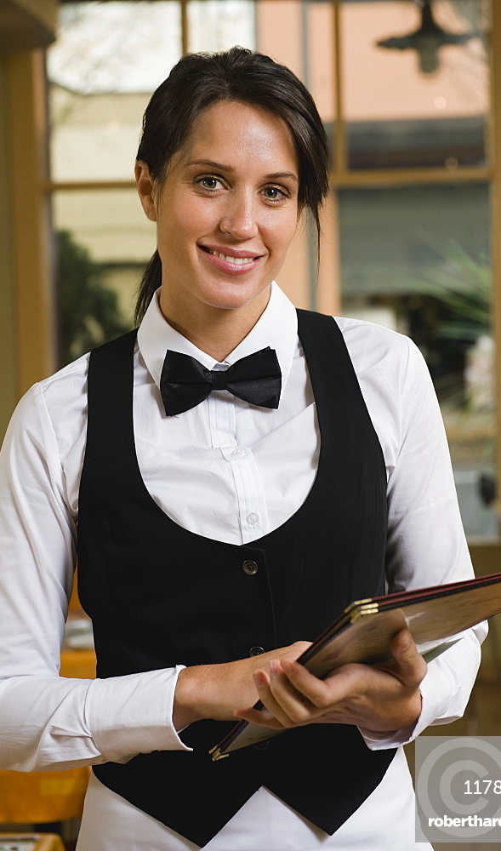
Unstated REQUIREMENTS WAITER
Tips
Order on time
(customers should decide quickly)
STATED REQUIREMENTS WAITER
No complaints from the customer
Mood of the customer
Food prepared on time

Slide 7

UNSTATED REQUIREMENTS CUSTOMER
Well trained chef
Polite waiters
Reasonable price
STATED REQUIREMENTS CUSTOMER
Ambience
Good food
Less waiting time

Slide 8


